Slide 1
Operationalizing the Micro Mindset in the Classroom
Tips and Tricks for Helping Students Take Charge of Their Own Learning
Copyright © 2022 by MicroSociety, Inc. All rights reserved. No part of this publication may be reproduced, disseminated, or transmitted in any manner without written permission of MicroSociety.

Slide 2
Session Goals
Our time in this session will help us:
Discuss several strategies to help empower students as leaders who own their own learning and provide helpful examples and resources.
Provide a space for us to share what has worked in our own classrooms and collaborate with other educators.
Copyright © 2022 by MicroSociety, Inc. All rights reserved. No part of this publication may be reproduced, disseminated, or transmitted in any manner without written permission of MicroSociety.

Slide 3
Important Notes to Keep in Mind
There are many years of experience in this room.
The strategies we present are not meant to be an exhaustive list.
Not all strategies will work for all classrooms.
However, there is still an amazing chance to take what we can, share what we’ve done, and build stronger classrooms for our students.
Copyright © 2022 by MicroSociety, Inc. All rights reserved. No part of this publication may be reproduced, disseminated, or transmitted in any manner without written permission of MicroSociety.

Slide 4
01
Strategies
How can we consider all aspects of our classrooms to help foster the skills students are already demonstrating in MicroSociety?
Copyright © 2022 by MicroSociety, Inc. All rights reserved. No part of this publication may be reproduced, disseminated, or transmitted in any manner without written permission of MicroSociety.

Slide 5
Let’s talk strategies!
Classroom Structures
How can we set up different classroom systems and routines to empower students?
Lesson Structures
How can we structure our lessons to provide opportunities for kids to own their learning?
Collaboration Structures
How can we facilitate students working together so they can practice curiosity, teamwork, and leadership?
Copyright © 2022 by MicroSociety, Inc. All rights reserved. No part of this publication may be reproduced, disseminated, or transmitted in any manner without written permission of MicroSociety.

Slide 6
Classroom Structures
How can we set up different classroom systems and routines to empower students?
Copyright © 2022 by MicroSociety, Inc. All rights reserved. No part of this publication may be reproduced, disseminated, or transmitted in any manner without written permission of MicroSociety.

Slide 7
What do we mean by classroom structures?
Student Jobs
Physical space
Copyright © 2022 by MicroSociety, Inc. All rights reserved. No part of this publication may be reproduced, disseminated, or transmitted in any manner without written permission of MicroSociety.

Slide 8
Student jobs that can foster student leadership and ownership
Classroom Jobs | Guiding Question | Potential Responsibilities
Materials Manager | How can we give students the chance to organize or take care of the space in our classroom? | Pass out / collect papers Ensure the classroom is clean when students exit and encourage their peers to help Sharpen pencils or manage the procedure for writing utensils
Announcer | How can we encourage students to own the information they need and listen to their peers rather than the solely the adult with them? | Read announcements out loud for the class for school announcements and/or classroom specific announcements Manage a class bulletin board
Copyright © 2022 by MicroSociety, Inc. All rights reserved. No part of this publication may be reproduced, disseminated, or transmitted in any manner without written permission of MicroSociety.

Slide 9
Student jobs that can foster student leadership
Classroom Jobs | Guiding Question | Potential Responsibilities
Teaching Assistant | How can we facilitate students teaching each other and tutoring their peers? | Lead small groups of students through a specific task Partner with a peer to help them focus on a key skill Organize study groups for their peers
Discussion Facilitator | When we use discussions in our class, how can we empower students to lead those discussions? | Remind the class of how to contribute during a discussion Monitor the discussion for equity of voice and encourage all students to participate
Copyright © 2022 by MicroSociety, Inc. All rights reserved. No part of this publication may be reproduced, disseminated, or transmitted in any manner without written permission of MicroSociety.

Slide 10
Physical Space
Here are some considerations for organizing the classroom space to put the power in students’ hands rather than solely in the teachers’ hands:
Are there ways to encourage group work?
Are there spaces where students can go to get the materials they need without teacher help?
Is there a space for students to get additional resources or ask questions?
Copyright © 2022 by MicroSociety, Inc. All rights reserved. No part of this publication may be reproduced, disseminated, or transmitted in any manner without written permission of MicroSociety.

Slide 11
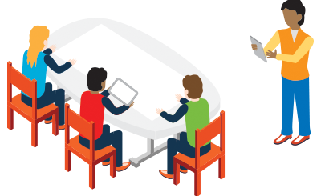
Examples of ways to organize physical space
Copyright © 2022 by MicroSociety, Inc. All rights reserved. No part of this publication may be reproduced, disseminated, or transmitted in any manner without written permission of MicroSociety.

Slide 12
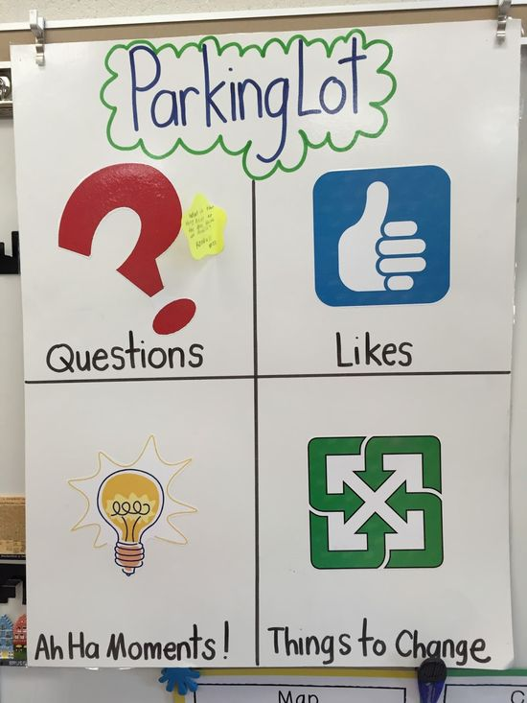
A parking lot is a place for students to write their questions, thoughts, and more on sticky notes. It can live as a permanent part of the classroom or be tailored to specific units or projects.
Copyright © 2022 by MicroSociety, Inc. All rights reserved. No part of this publication may be reproduced, disseminated, or transmitted in any manner without written permission of MicroSociety.

Slide 13
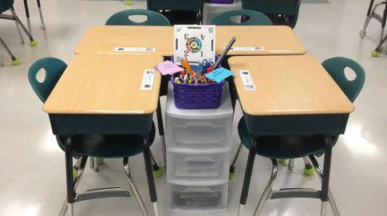
One way to organize desks is in groups, and there are also ways to equip each pod with the tools they need to be successful if you are doing a project.
Copyright © 2022 by MicroSociety, Inc. All rights reserved. No part of this publication may be reproduced, disseminated, or transmitted in any manner without written permission of MicroSociety.

Slide 14
If you have a classroom library, consider giving students a chance to recommend books. Or, if you teach another content, think about how to spotlight students’ ideas or suggestions that can help their peers.
Copyright © 2022 by MicroSociety, Inc. All rights reserved. No part of this publication may be reproduced, disseminated, or transmitted in any manner without written permission of MicroSociety.

Slide 15
Lesson Structures
How can we structure our lessons to provide opportunities for kids to own their learning?
Copyright © 2022 by MicroSociety, Inc. All rights reserved. No part of this publication may be reproduced, disseminated, or transmitted in any manner without written permission of MicroSociety.

Slide 16
1
2
Student Choice
Reflection
3
4
5
Discussion
Tracking Growth
Group Work
Elements to consider in our planning
How can we give students choice in their assignments?
How can we build in time for students to reflect on their own learning?
How can we give students more opportunities to process their ideas verbally and get feedback?
How can we help students see the importance of growth in addition to proficiency?
How can we foster communication and teamwork among students?
Copyright © 2022 by MicroSociety, Inc. All rights reserved. No part of this publication may be reproduced, disseminated, or transmitted in any manner without written permission of MicroSociety.

Slide 17
Important note
Depending on our individual contexts, we may have different constraints with our lessons.
The goal of this part of our session is to think outside the box and see what we can adapt to our own classrooms.
Copyright © 2022 by MicroSociety, Inc. All rights reserved. No part of this publication may be reproduced, disseminated, or transmitted in any manner without written permission of MicroSociety.

Slide 18
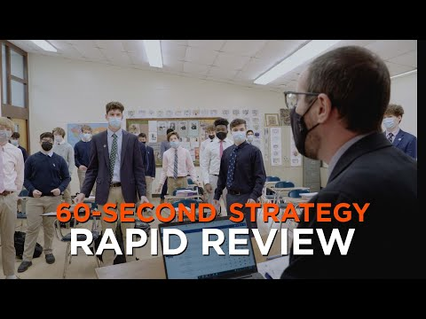
Example #1
Copyright © 2022 by MicroSociety, Inc. All rights reserved. No part of this publication may be reproduced, disseminated, or transmitted in any manner without written permission of MicroSociety.

Slide 19
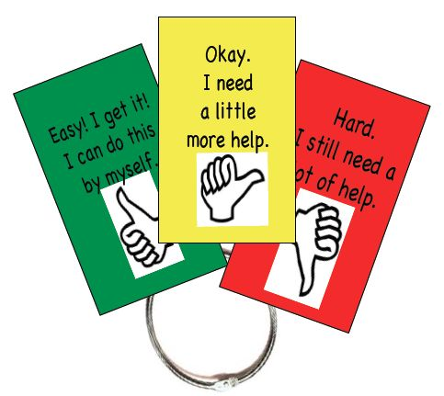
Example #2
Consider ways to help students advocate for themselves and reflect on the level of support they need in any given lesson.
Copyright © 2022 by MicroSociety, Inc. All rights reserved. No part of this publication may be reproduced, disseminated, or transmitted in any manner without written permission of MicroSociety.

Slide 20
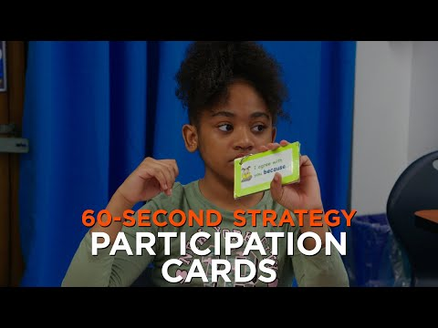
Example #3
Copyright © 2022 by MicroSociety, Inc. All rights reserved. No part of this publication may be reproduced, disseminated, or transmitted in any manner without written permission of MicroSociety.

Slide 21
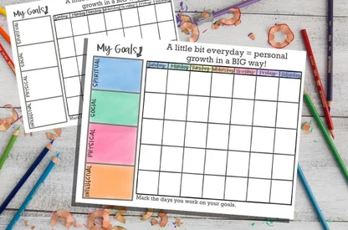
Example #4
Consider ways to help students keep track of their progress and growth. This can be done individually or publicly.
Copyright © 2022 by MicroSociety, Inc. All rights reserved. No part of this publication may be reproduced, disseminated, or transmitted in any manner without written permission of MicroSociety.

Slide 22
Collaboration Structures
How can we facilitate students working together so they can practice curiosity, team work, and leadership?
Copyright © 2022 by MicroSociety, Inc. All rights reserved. No part of this publication may be reproduced, disseminated, or transmitted in any manner without written permission of MicroSociety.

Slide 23
Guiding Principles for Group Work
Clear task and deliverable
Everyone needs a role
Form of accountability
Copyright © 2022 by MicroSociety, Inc. All rights reserved. No part of this publication may be reproduced, disseminated, or transmitted in any manner without written permission of MicroSociety.

Slide 24
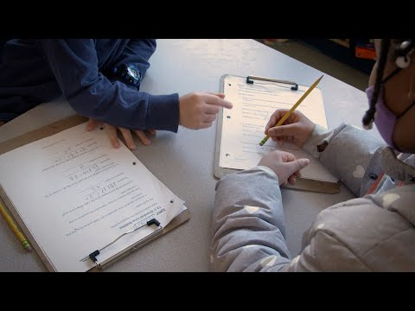
Example #1
Copyright © 2022 by MicroSociety, Inc. All rights reserved. No part of this publication may be reproduced, disseminated, or transmitted in any manner without written permission of MicroSociety.

Slide 25
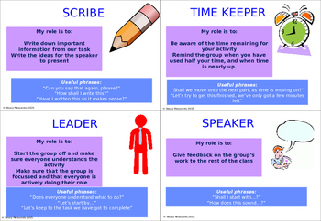
Example #2
Consider creating group role cards so students are clear on what they need to be doing while they work in their group.
Copyright © 2022 by MicroSociety, Inc. All rights reserved. No part of this publication may be reproduced, disseminated, or transmitted in any manner without written permission of MicroSociety.

Slide 26
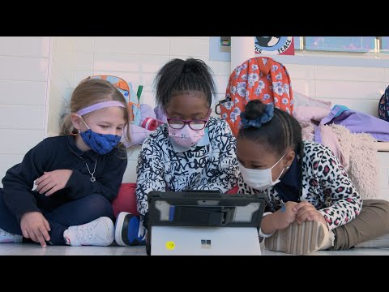
Example #3
Copyright © 2022 by MicroSociety, Inc. All rights reserved. No part of this publication may be reproduced, disseminated, or transmitted in any manner without written permission of MicroSociety.

Slide 27
02
Sharing from our experiences
How are we can learn from each other in order to support our students in this journey?
Copyright © 2021 by MicroSociety, Inc. All rights reserved. No part of this publication may be reproduced, disseminated, or transmitted in any manner without written permission of MicroSociety.

Slide 28
Collaborating Time!
Our hope is that the strategies and tips we’ve gone over were helpful!
Maybe you have used some, or maybe there were some new ones you hadn’t considered before.
Either way, this is now a chance for us to lean on each other as experts in our classroom.
Copyright © 2021 by MicroSociety, Inc. All rights reserved. No part of this publication may be reproduced, disseminated, or transmitted in any manner without written permission of MicroSociety.

Slide 29
Discussion
Using the time we have left, choose some of the questions below to discuss:
What strategies have you used before to empower student leadership?
Are there additional strategies you would add to what we talked about?
What strategies do you want to hold onto for next year?
Copyright © 2021 by MicroSociety, Inc. All rights reserved. No part of this publication may be reproduced, disseminated, or transmitted in any manner without written permission of MicroSociety.

Slide 30
Thank You!
We appreciate all you do in supporting students as they grow to be leaders and own their learning!
Copyright © 2022 by MicroSociety, Inc. All rights reserved. No part of this publication may be reproduced, disseminated, or transmitted in any manner without written permission of MicroSociety.

